Slide 1
Numbers: int, double.
String
create a multi-line string: use a triple quote with either
single or double quotation marks ’’’ .
You can concatenate strings using adjacent string literals
or the + operator
You can put the value of an expression inside a string by
using ${expression}. If the
expression is an identifier, you can skip the {}. To get the
string corresponding to an object,
Dart calls the object’s toString() method.Bool

Slide 2
List
dart 2.3 introduced the spread operator (...) and the null-aware spread operator (...?),
which provide a concise way to insert multiple elements into a collection. … , …?
List vs iterator
Notes:
Add
Length
map
Every and any
reduce
WHERE
WhereType
INSERT, insertAll
Reversed
isEmpty
isNotEmpty
sort

Slide 3
Sets
A set in Dart is an unordered collection of unique items. Dart support for sets is provided by set literals and the Set type.
var halogens = {'fluorine', 'chlorine', 'bromine', 'iodine', 'astatine'};
Use .length to get the number of items in the set
Notes:
var numbers2 = numbers.toList()..sort();

Slide 4
Add items to an existing set using the add() or addAll() methods:
var elements = <String>{};
elements.add('fluorine');
elements.addAll(halogens);
Set.elementAt()-> to get specific element
Set.map(function).toList() to map set elements

Slide 5
To create a set that’s a compile-time constant, add const before the set literal:
final constantSet = const {
'fluorine',
'chlorine',
'bromine',
'iodine',
'astatine',
};
// constantSet.add('helium'); // Uncommenting this causes an error.

Slide 6
As of Dart 2.3, sets support spread operators (... and ...?) and collection ifs and fors, just like lists do.

Slide 7
Maps
In general, a map is an object that associates keys and values. Both keys and values can be any type of object. Each key occurs only once, but you can use the same value multiple times
var gifts = {
// Key: Value
'first': 'partridge',
'second': 'turtledoves',
'fifth': 'golden rings'
};
Notes:
cotainsKey
containsValue
putIfAbsence
forEach
iterators

Slide 8
var gifts = Map();
gifts['first'] = 'partridge';
gifts['second'] = 'turtledoves';
gifts['fifth'] = 'golden rings';
Use .length to get the number of key-value pairs in the map

Slide 9
To create a map that’s a compile-time constant, add const before the map literal:
final constantMap = const {
2: 'helium',
10: 'neon',
18: 'argon',
};
// constantMap[2] = 'Helium'; // Uncommenting this causes an error.

Slide 10
As of Dart 2.3, maps support spread operators (... and ...?) and collection if and for, just like lists do.

Slide 11
Enum
enum x {amed,ali,hasan}

Slide 12
Functions
Dart is a true object-oriented language, so even functions are objects and have a type, Function. This means that functions can be assigned to variables or passed as arguments to other functions.
ex:
pass method as parameter
int sum(Function(int,int) x, Function(int) y,int num1,int num2, int num3){
return x(num1,num2)+y(num3);
}

Slide 13
call defined method
var result = Test().sum(firstFun, secondFun, 1, 2, 3);
print('result is $result');
int firstFun(int x,int y){
return x*y;
}
int secondFun(int z){
z++;
return z;
}

Slide 14
typeDef is used to define new function form
typedef String myFunction(String x , String y)
here we have defined new function form called myFunction which has String as output and two strings as input.
we don't apply body we just determine the syntax of the function
We just define how is the header of the function is, I mean return value and parameter.

Slide 15
The => expr syntax is a shorthand for { return expr; }. The => notation is sometimes referred to as arrow syntax.

Slide 16
Optional parameters
Optional parameters can be either named or positional, but not both.
Named parameters
When calling a function, you can specify named parameters using paramName: value. For example:
enableFlags(bold: true, hidden: false);
When defining a function, use {param1, param2, …} to specify named parameters:
void enableFlags({bool bold, bool hidden}) {...}

Slide 17
Although named parameters are a kind of optional parameter, you can annotate them with @required to indicate that the parameter is mandatory — that users must provide a value for the parameter. For example:
const Scrollbar({Key key, @required Widget child})
Must import 'package:meta/meta.dart';
https://pub.dev/packages/meta#-installing-tab-

Slide 18
Positional parameters
Wrapping a set of function parameters in [] marks them as optional positional parameters:
String say(String from, String msg, [String device]) {
var result = '$from says $msg';
if (device != null) {
result = '$result with a $device';
}
return result;
}

Slide 19
Default parameter values
Your function can use = to define default values for both named and positional parameters. The default values must be compile-time constants. If no default value is provided, the default value is null.
void enableFlags({bool bold = false, bool hidden = false}) {...}

Slide 20
The main() function
Every app must have a top-level main() function, which serves as the entrypoint to the app. The main() function returns void and has an optional List<String> parameter for arguments.

Slide 21
Anonymous functions
Most functions are named, such as main() or printElement(). You can also create a nameless function called an anonymous function, or sometimes a lambda or closure. You might assign an anonymous function to a variable so that, for example, you can add or remove it from a collection.
var list = ['apples', 'bananas', 'oranges'];
list.forEach((item) {
print('${list.indexOf(item)}: $item');
});

Slide 22
Lexical scope
Dart is a lexically scoped language, which means that the scope of variables is determined statically, simply by the layout of the code. You can “follow the curly braces outwards” to see if a variable is in scope.

Slide 23
Operators
Arithmetic operators
Dart supports the usual arithmetic operators, as shown in the following table.
Operator Meaning
+ Add
– Subtract
-expr Unary minus, also known as negation (reverse the sign of the expression)
* Multiply
/ Divide

Slide 24
~/ Divide, returning an integer result
% Get the remainder of an integer division ++var var = var + 1 (expression value is var + 1)
var++ var = var + 1 (expression value is var)
--var var = var – 1 (expression value is var – 1)
var-- var = var – 1 (expression value is var)

Slide 25
Equality and relational operators
The following table lists the meanings of equality and relational operators.
Operator Meaning
== Equal; see discussion below
!= Not equal
> Greater than
< Less than
>= Greater than or equal to
<= Less than or equal to

Slide 26
Assignment operators
As you’ve already seen, you can assign values using the = operator. To assign only if the assigned-to variable is null, use the ??= operator.
// Assign value to a
a = value;
// Assign value to b if b is null; otherwise, b stays the same
b ??= value;

Slide 27
Logical operators
You can invert or combine boolean expressions using the logical operators.
Operator Meaning
!expr inverts the following expression (changes false to true, and vice versa)
|| logical OR
&& logical AND

Slide 28
Conditional expressions
Dart has two operators that let you concisely evaluate expressions that might otherwise require if-else statements:
condition ? expr1 : expr2
If condition is true, evaluates expr1 (and returns its value); otherwise, evaluates and returns the value of expr2.
expr1 ?? expr2
If expr1 is non-null, returns its value; otherwise, evaluates and returns the value of expr2.

Slide 29
Control flow statements
You can control the flow of your Dart code using any of the following:
if and else
for loops
while and do-while loops
break and continue
switch and case
assert

Slide 30
Exceptions
Your Dart code can throw and catch exceptions. Exceptions are errors indicating that something unexpected happened. If the exception isn’t caught, the isolate that raised the exception is suspended, and typically the isolate and its program are terminated.

Slide 31
IntegerDivisionByZeroException.
try {
int firstInput = 20;
int secondInput = 0;
int result = firstInput ~/ secondInput;
print('The result of $firstInput divided by $secondInput is $result');
} on IntegerDivisionByZeroException {
print('The division by 0 is causing Exception ');
}

Slide 32
IOException.
IsolateSpawnException.
TimeoutException.
FormatException.
DeferredLoadException.
Custom exception

Slide 33
Throw
Here’s an example of throwing, or raising, an exception:
throw FormatException('Expected at least 1 section');

Slide 34
Catch
Catching, or capturing, an exception stops the exception from propagating (unless you rethrow the exception). Catching an exception gives you a chance to handle it:
try {
breedMoreLlamas();
} on OutOfLlamasException {
buyMoreLlamas();
}

Slide 35
Finally
To ensure that some code runs whether or not an exception is thrown, use a finally clause. If no catch clause matches the exception, the exception is propagated after the finally clause runs

Slide 36
Classes
Dart is an object-oriented language with classes and mixin-based inheritance. Every object is an instance of a class, and all classes descend from Object. Mixin-based inheritance means that although every class (except for Object) has exactly one superclass, a class body can be reused in multiple class hierarchies.

Slide 37
Using constructors
ou can create an object using a constructor. Constructor names can be either ClassName or ClassName.identifier. For example, the following code creates Point objects using the Point() and Point.fromJson() constructors:
var p1 = Point(2, 2);
var p2 = Point.fromJson({'x': 1, 'y': 2});

Slide 38
Getting an object’s type
To get an object’s type at runtime, you can use Object’s runtimeType property, which returns a Type object.

Slide 39
invoking a non-default superclass constructor
By default, a constructor in a subclass calls the superclass’s unnamed, no-argument constructor. The superclass’s constructor is called at the beginning of the constructor body. If an initializer list is also being used, it executes before the superclass is called. In summary, the order of execution is as follows

Slide 40
initializer list
superclass’s no-arg constructor
main class’s no-arg constructor
If the superclass doesn’t have an unnamed, no-argument constructor, then you must manually call one of the constructors in the superclass. Specify the superclass constructor after a colon (:), just before the constructor body (if any).

Slide 41
Cascade notation (..)
Cascades (..) allow you to make a sequence of operations on the same object. In addition to function calls, you can also access fields on that same object. This often saves you the step of creating a temporary variable and allows you to write more fluid code.

Slide 42
You can prevent inheritance by using private constructor for the class
class Test{
Test._();
}

Slide 43
Getters and setters
Getters and setters are special methods that provide read and write access to an object’s properties. Recall that each instance variable has an implicit getter, plus a setter if appropriate. You can create additional properties by implementing getters and setters, using the get and set keywords:

Slide 44
Abstract methods
Instance, getter, and setter methods can be abstract, defining an interface but leaving its implementation up to other classes. Abstract methods can only exist in abstract classes.
To make a method abstract, use a semicolon (;) instead of a method body:

Slide 45
Type test operators
The as, is, and is! operators are handy for checking types at runtime.
Operator Meaning
as Typecast (also used to specify library prefixes)
is True if the object has the specified type
is! False if the object has the specified type

Slide 46
Abstract classes
Use the abstract modifier to define an abstract class—a class that can’t be instantiated. Abstract classes are useful for defining interfaces, often with some implementation. If you want your abstract class to appear to be instantiable

Slide 47
class Person {
String firstName;
Person.fromJson(Map data) {
print('in Person');
}
}
Employee(this.name,this.address,this.age,this.sons,this.tel);
class Employee extends Person {
Employee.fromJson(Map data) : super.fromJson(data) {
print('in Employee');
}
}

Slide 48
Implicit interfaces
Every class implicitly defines an interface containing all the instance members of the class and of any interfaces it implements. If you want to create a class A that supports class B’s API without inheriting B’s implementation, class A should implement the B interface.

Slide 49
Extending a class
Use extends to create a subclass, and super to refer to the superclass

Slide 50
Overriding members
Subclasses can override instance methods, getters, and setters. You can use the @override annotation to indicate that you are intentionally overriding a member

Slide 51
var
A way to declare a variable without specifying its type, but if we assign specific type for the variable, we wont be able to change the variable type anymore
dynamic
an object wich is not restricted to a single type, that means we can change the variable type whenever we want

Slide 52
"static" means a member is available on the class itself instead of on instances of the class. That's all it means, and it isn't used for anything else
ex: className.(static variable)
"final" means single-assignment: a final variable or field *must* have an initializer. Once assigned a value, a final variable's value cannot be changed

Slide 53
Const
If the value is value you have is computed at runtime (new DateTime.now(), for example), you can not use a const for it. However, if the value is known at compile time (const a = 1;), then you should use const over final.
if you're using const, you have to declare it as static const rather than just const.
if you have a const collection, everything inside of that is in const. If you have a final collection, everything inside of that is not final.

Slide 54
Final
final should be used over const if you don't know the value at compile time, and it will be calculated/grabbed at runtime. If you want an HTTP response that can't be changed, if you want to get something from a database, or if you want to read from a local file, use final. Anything that isn't known at compile time should be final over const.

Slide 55
In OOP, an interface is something that enforces the deriving class to implement a set list of public fields and methods.
But unlike other traditional programming languages like C# and JAVA, Dart does not have explicit interface types. Each class, by default, defines its own interface composed of public fields and methods. So, every class can act as an interface in Dart.
We use the implements keyword to implement an interface. Also, a class can implement multiple interfaces.

Slide 56
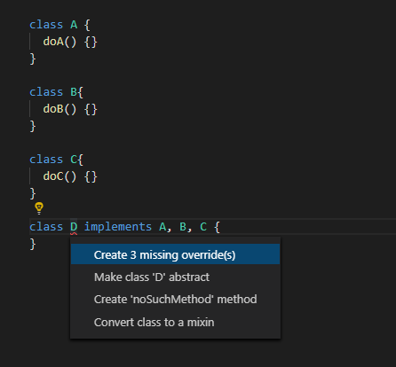
In the example above, class D implements classes A, B and C therefore it must implement the public methods and fields of those classes.
Furthermore, since Dart does not have explicit interfaces, we use the abstract class as an interface.

Slide 57
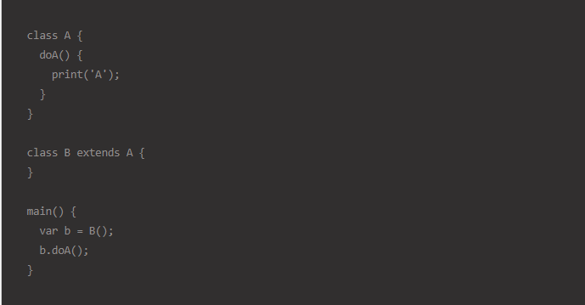
In OOP, inheritance implies sharing of behavior between classes. We can not share features with an interface. So, when we implement a class, we can not share it’s behavior

Slide 58
In the above example, since B extends A, you can call the doA() method directly from B’s object.
Unlike implementing multiple interfaces, Dart only supports single inheritance. So, you can not extend from multiple classes.

Slide 59
In OOP, a mixin is a class that contains methods for use by other classes. Unlike the interface and inheritance approach, a mixin doesn’t have to be the parent class of those other classes
You will usually put common functions inside a mixin. In Dart, we make use of the mixin by using the with keyword.

Slide 60
Mixin classes cant contain any constructor

Slide 61
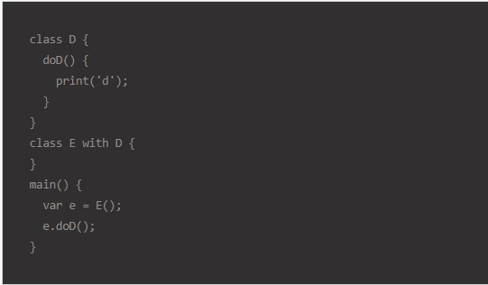
In Dart, a class can also be used as mixin if the class is constructor-less. For example, the code below is valid.

Slide 62
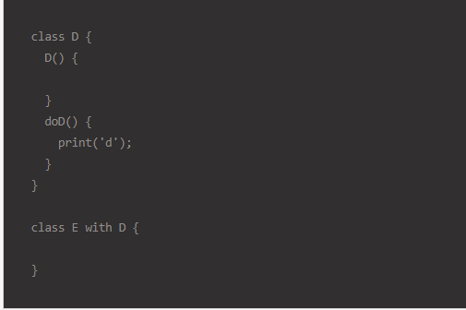
But this one below is invalid because class D declares a constructor.

Slide 63
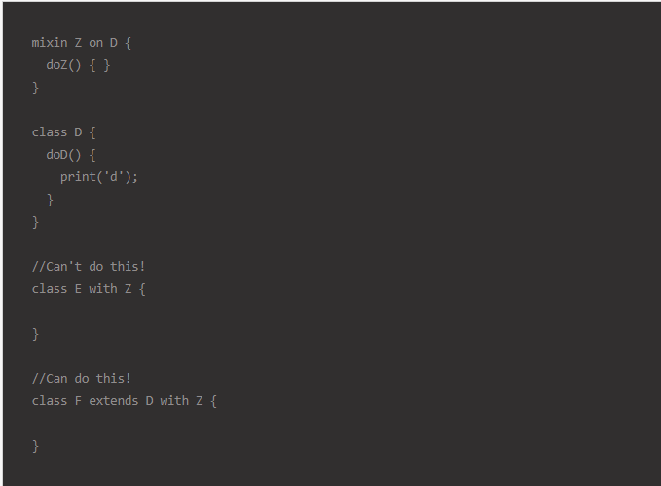
You can also enforce a mixin to be usable for certain types classes only by using the the on keyword when defining the mixin.

Slide 64
Conclusion
Implements for enforcing behaviors.
Extends for sharing behaviors of single class.
Mixins for sharing behaviors from multiple reusable types.

Slide 65
we can hide variables or method from outside world using _ symbol, it equals private in java

Slide 66
dart have not ability to make final class to prevent inheretance not initializing, but we can make class's constructor private so it cant be access from any class nor initialize new object from it.

Slide 67
you can use abstract with class to prevent initializing new instances from the class.

Slide 68
abstract class is the class that has one abstract method at least

Slide 69
you can inherit other class but you have to pass what parent class's constructor needs first
ex:
class Test1{Test1(int x);}
class Test2 extends Test1{
Test2():super(int x);
}

Slide 70
super vs this
implements vs extends

Slide 71
Dartlang and something i haven’t seen before.

Slide 72
Optional named parameters
When calling a function, you can specify named parameters
using paramName: value. For example:
enableFlags(bold: true, hidden: false);
When defining a function, use {param1, param2, …} to specify
named parameters:
void enableFlags({bool bold, bool hidden}) {}

Slide 73
~/Divide, returning an integer result
assert(5 ~/ 2 == 2); // Result is an int

Slide 74
Cascade notation (..)
Cascades (..) allow you to make a sequence of operations on the same object. In addition to function calls, you can also access fields on that same object. This often saves you the step of creating a temporary variable and allows you to write more fluid code.
querySelector('#confirm') // Get an object. ..text = 'Confirm' // Use its members. ..classes.add('important') ..onClick.listen((e) => window.alert('Confirmed!'));

Slide 75
expr1 ?? Expr2
If expr1 is non-null, returns its value; otherwise, evaluates and returns the value of expr2.

Slide 76
Named constructors
Use a named constructor to implement multiple constructors for a class or to provide extra clarity:
class Point { num x, y; Point(this.x, this.y); Point.origin() { x = 0; y = 0; } }

Slide 77
invoking a non-default superclass constructor
class Person { String firstName;Person.fromJson(Map data) { print('in Person'); } }
class Employee extends Person { Employee.fromJson(Map data) : super.fromJson(data) { print('in Employee'); } }

Slide 78
Initializer list
Besides invoking a superclass constructor, you can also initialize instance variables before the constructor body runs. Separate initializers with commas.
Point.fromJson(Map<String, num> json) : x = json['x'], y = json['y'] { print('In Point.fromJson(): ($x, $y)'); }

Slide 79
Mixins
Libraries and visibility
Importing only part of a library
If you want to use only part of a library, you can selectively import the library. For example:
// Import only foo. import 'package:lib1/lib1.dart' show foo;// Import all names EXCEPT foo. import 'package:lib2/lib2.dart' hide foo;

Slide 80
Overridable operators
class TestClass{
int x;
int y;
TestClass(this.x,this.y);
TestClass operator + (TestClass test) => TestClass(x+test.x,y+test.y);
}

Slide 81
Factory constructor
factory Color(String color){
if(color=='black'){return Color._black();}
else if(color=='white'){return Color._white();}
else{return null;}} Color._black(){
this.red=0;
this.green=0;
this.blue=0;
} Color._white(){
this.red=255;
this.green=255;
this.blue=255;
}

Slide 82
Generics
We can assign a type of any variable, function or parameter
Add<k>(kx,ky)
It means that the add function should be recive its tyoe and the parameter must be the same type
Ex:
Add<String>(String x, String y)
Add<t extends num>(t x, t y){}
Here the methods geniric type has to be number, it means double or integer

Slide 83
Generic class
Class x< T extends num>{
T VALUE1;
List<T> values;
…… }
So here we use the generic to assign class a specific type of values so we cant pass any tyoe expect T to class varuables or methods

Slide 84
Os variables
Platform.operatingSystem
Patform.isWindows
Platform.enviroment => map of envirment name as jey and its values

